Slide 1

JAVA Programming UNIT II
Presentation on
Dr. P. Sita Rama Murty
Associate Professor
Dept. of Information Technology
Vishnu Institute of Technology, Bhimavaram

Slide 2
Classes & Objects
class declaration
creating objects
methods
constructors and constructor overloading
garbage collector
importance of static keyword and examples
this keyword
arrays
command line arguments
nested classes

Slide 3
Classes & Objects
class declaration
creating objects
methods
constructors and constructor overloading
garbage collector
importance of static keyword and examples
this keyword
arrays
command line arguments
nested classes

Slide 4
Classes & Objects
Class is core of java.
Class contains data and code that operates on that data.
We can say that, “classes are categories and objects are items within that category”.
A class is declared by using the keyword “class”.

Slide 5


Slide 6
Classes & Objects
General form of class:
class classname{
type instance_variable1;
type instance_variable2;
…….
type method_name1(parameter-list){
body of method;
}
type method_name2(parameter-list){
body of method;
}
…..
}

Slide 7
Classes & Objects
The methods and variables defined within the class are called members of class.
Variables defined within a class are called instance variables because each instance of the class contains its own copy of these variables.
The methods of the class determines how the class data can be used.

Slide 8
Class Box{
double width;
double height;
double depth;
double volume(){
return width*height*depth;
}
}

Slide 9
Classes & Objects
class declaration
creating objects
methods
constructors and constructor overloading
garbage collector
importance of static keyword and examples
this keyword
arrays
command line arguments
nested classes

Slide 10
Creating Objects
When you create a class you are creating a new data type.
To create an object (or instance of a class) use the following syntax
classname objname = new classname()
classname: is the name of the class.
classname(): the constructor for class.
“new” operator dynamically allocates memory to the object.

Slide 11
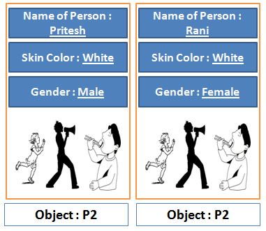

Slide 12
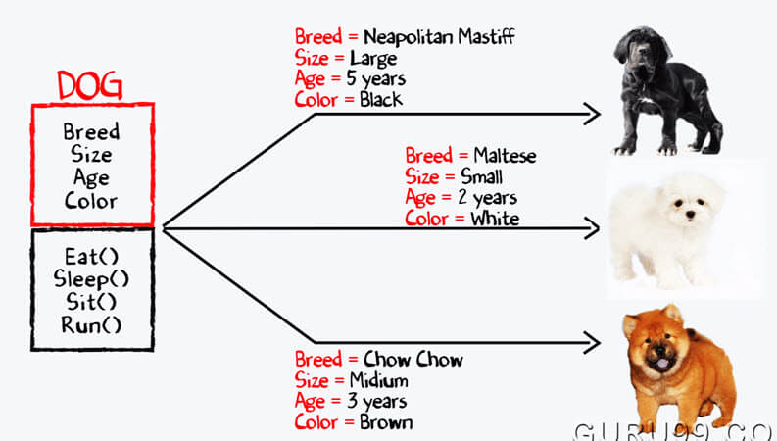

Slide 13
Creating Objects
Box b1 = new Box();
b1, is an instance of Box class, b1 contains its own copies of variables (width, height and depth) and methods.
To access these variables and methods we must use the dot operator.
b1.width = 50.2;
b1.volume();

Slide 14
Classes & Objects
class declaration
creating objects
methods
constructors and constructor overloading
garbage collector
importance of static keyword and examples
this keyword
arrays
command line arguments
nested classes

Slide 15
Methods
Classes usually contain two things: instance variables and methods.
Methods contain the code that operates on the instance variables.
The general form of a method is:
return-type method-name(parameter-list){
//body of method
}

Slide 16
Methods
return-type: Type of data returned by the method.
“void” if no value is returned.
Even class can be returned.
name: The name of the method. This can be any legal identifier which is not already used.
parameter-list: Sequence of type and identifier pairs separated by commas.

Slide 17
Methods
Method Overloading: In java it is possible to define two or more methods with the same name in the same class, as long as their parameter declarations are different.
Method overloading is one of the ways by which java supports polymorphism.
When an overloaded method is invoked, java uses the type and / or the number of arguments as its guide to determine which version of the overloaded method to call.

Slide 18
class OverloadDemo {
void test() {
System.out.println("No parameters");
}
void test(int a, int b) {
System.out.println("a and b: " + a + " " + b);
}
void test(double a) {
System.out.println("Inside test(double) a: " + a);
}
}
class Overload {
public static void main(String args[]) {
OverloadDemo ob = new OverloadDemo();
int i = 88;
ob.test();
ob.test(10, 20);
ob.test(i); // this will invoke test(double)
ob.test(123.2); // this will invoke test(double)
}
}
Notes:
Use editor and explain the program

Slide 19
Classes & Objects
class declaration
creating objects
methods
constructors and constructor overloading
garbage collector
importance of static keyword and examples
this keyword
arrays
command line arguments
nested classes

Slide 20
Constructors
Used to initialize objects.
Same name as the class.
Similar to method.
No return type.

Slide 21
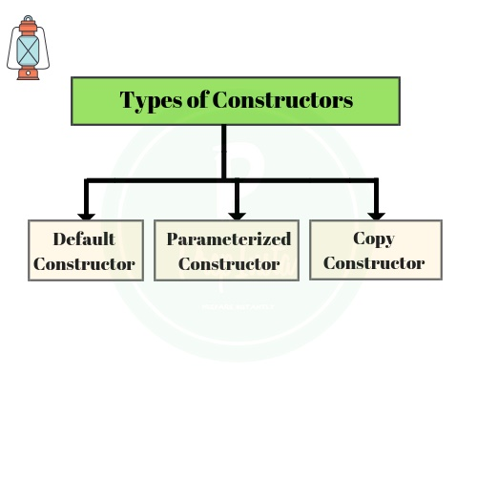

Slide 22
Constructors
Default Constructor: The constructor with out parameters.
java creates a default constructor, if developer didn’t.
classname(){
//body of the constructor
}

Slide 23
Constructor
Example:
Box(){
width=3;
height=6;
depth=4;
}
How to create objects with different dimensions?

Slide 24
Constructors
Parameterized constructor: The constructor that has parameters is called parameterized constructor.
Box(double w, double h, double d){
width = w;
height = h;
depth = d;
}

Slide 25
constructors
To create objects with different dimensions, it is comfortable to use parameterized constructors
Box(double width, double height, double depth){
this.width = width;
this.height = height;
this.depth=depth;
}

Slide 26
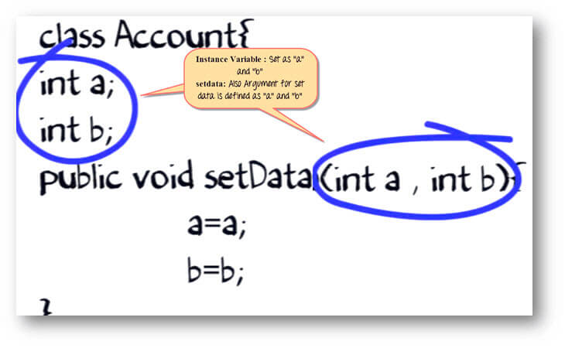

Slide 27
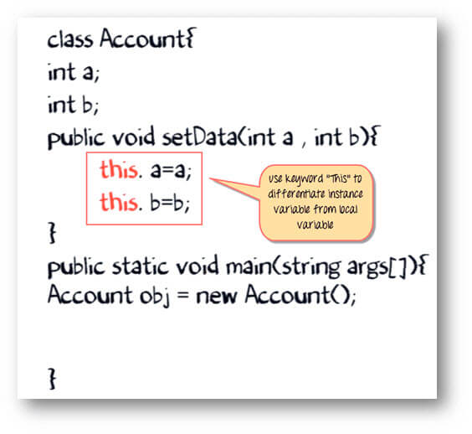

Slide 28
constructors
Copy Constructor:
To clone an object from another object.
A copy constructor take object of its class as a parameter.
Box(Box ob){
width= ob.width;
height = ob.height;
depth = ob.depth;
}

Slide 29
constructors
This will create an object with the same dimensions as the object that is passed.

Slide 30
constructors
Constructor Overloading:
Constructors can be overloaded.
In a class more than one constructor can be declared.
The constructors must differ in the order / type of parameters passed.

Slide 31
Constructors
class Box{
double width, height, depth;
Box(){
width=10;
height=5;
depth=3;
}
Box(double w, double h, double d){
width=w;
height=h;
depth=d;
}
Box(Box s){
width=s.width;
height=s.height;
depth=s.depth;
}
double volume(){
return width*height*depth;
}
}
Box b1 = new Box();
Box b2 = new Box(3,4,5);
Box b3 = new Box(b2);
Notes:
Use code editor and explain the program

Slide 32
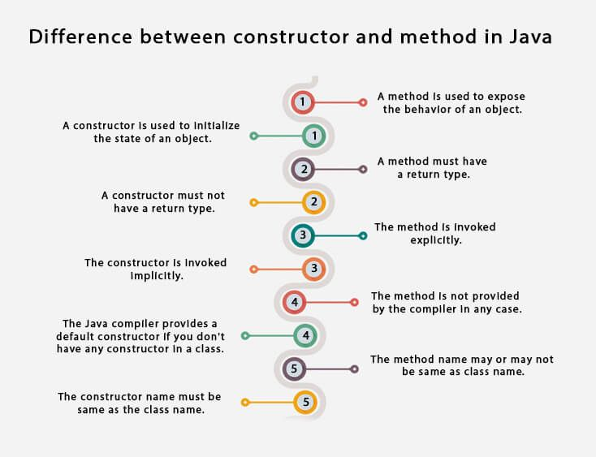

Slide 33
Classes & Objects
class declaration
creating objects
methods
constructors and constructor overloading
garbage collector
importance of static keyword and examples
this keyword
arrays
command line arguments
nested classes

Slide 34
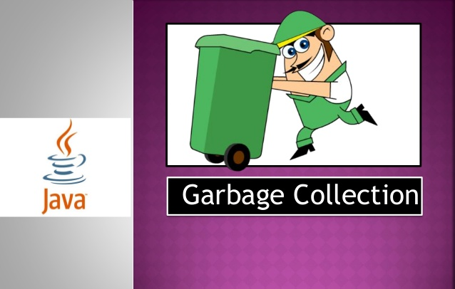

Slide 35
Garbage Collector
In java there is no explicit need to destroy objects as in C++.
Java handles de-allocation of memory automatically.
The technique that accomplishes this is called garbage collector.
Notes:
In C++ we use delete operator. In C we use free() to release dynamically allocated memory.

Slide 36
Garbage Collector
Garbage Collector works like this: when no references to an object exist, that object is assumed to be no longer needed, and the memory occupied by the object can be reclaimed.
Garbage collection only occurs sporadically (if at all) during the execution of your program.
It will not occur simply because one or more objects exist that are no longer used.
Notes:
In C++ we use delete operator. In C we use free() to release dynamically allocated memory.

Slide 37
Garbage Collector
import java.util.*;
class GarbageCollection { public static void main(String s[]) throws Exception { Runtime rs = Runtime.getRuntime(); System.out.println("Free memory in JVM before Garbage Collection = "+rs.freeMemory()); rs.gc(); System.out.println("Free memory in JVM after Garbage Collection = "+rs.freeMemory()); } }

Slide 38
Classes & Objects
class declaration
creating objects
methods
constructors and constructor overloading
garbage collector
importance of static keyword and examples
this keyword
arrays
command line arguments
nested classes

Slide 39
static
In java language static keyword can be used for the following
Instance variable
Methods
Block
Nested class
To make a member static, precede the declaration with the keyword static.
The members marked as static, belongs to the class rather than to any particular instance of the class.
Notes:
To access a member of the class, first we have to create its object, then we use dot operator (obj.member).

Slide 40
static
Normally a class member must be accessed only in conjunction with an object of its class.
Eg: b1.volume(), b1.width, b2.volume() etc.
When a member is declared as static, it can be accessed before any objects of its class is created, by using the given syntax
Eg: Classname.member, Box.staticmember().
Notes:
To access a member of the class, first we have to create its object, then we use dot operator (obj.member).

Slide 41
static
Most common example of a static member is main().
public static void main(String args[])#entry point
main() is declared as static because it must be called before any object exists.

Slide 42
static
Instance variable: Instance variables declared as static are essentially global variables.
When a variable is declared as static a single copy of the variable is created and shares over all objects.
All static variable of a class will be initialized before any objects of that class were created.

Slide 43
static
Methods declared as static have several restrictions:
They can only call other static methods.
They must only access static data.
They cannot refer to ‘this’ or ‘super’ in any way.

Slide 44
static
Block: A static block is executed exactly once when the class is first loaded.
One main use case of static block is to initialize static variables.
static {
//static variable initialization
}

Slide 45
Classes & Objects
class declaration
creating objects
methods
constructors and constructor overloading
garbage collector
importance of static keyword and examples
this keyword
arrays
command line arguments
nested classes

Slide 46
this
This refers to the current object. In the following cases we use this
Instance variable Hiding: When a local variable has the same name as an instance variable, the local variable hides the instance variable. To resolve this issue ‘this’ can be used.
To call constructor: this() can be used to invoke constructor (overloaded).
this() should be the first line in the constructor.
this() and super() cannot be used in the same constructor.

Slide 47
Classes & Objects
class declaration
creating objects
methods
constructors and constructor overloading
garbage collector
importance of static keyword and examples
this keyword
arrays
command line arguments
nested classes

Slide 48
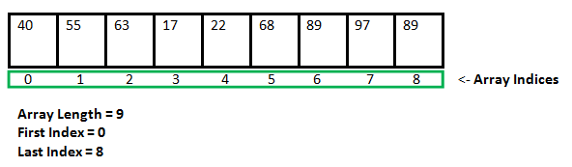
Array
An array is “a numbered sequence of elements which are all of same type”.
length – number of elements in an array.
A specific element in an array is accessed by its index.
array_name[index]

Slide 49
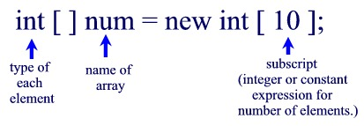
Array
Syntax for array declaration is
BaseType[] array_name = new BaseType[size];
int[] cubes = new int[9]; //int cubes[] = new int[9]

Slide 50
Array
Arrays can be initialized when they are declared.
An array initializer is a list of comma-separated expressions surrounded by curly braces.
int[] squares = {1, 4, 9, 16, 25, 36, 49, 64, 81};
The array will be created large enough to hold the elements you specify in the array initializer.
There is no need to use new.

Slide 51
Array
Array Processing: Applying the same operation to each element of the array.
Generally, for or for…each loop is used.
for(int i = 0; i< A.length; i++){
//process A[i]
}
for(BaseType item: anArray){
//process item
}

Slide 52
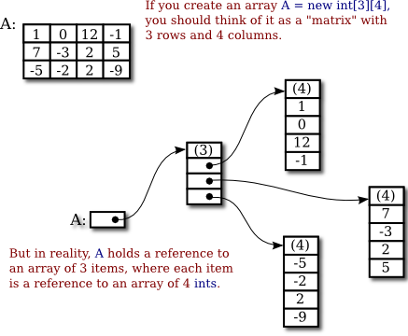
Array
Multidimensional Arrays: arrays of arrays.

Slide 53
Array
To declare a multidimensional array variable, specify each additional index using another set of square brackets.
int twoD[][] = new int[4][5];//two dimensional
To initialize a multidimensional array simply enclose each dimension initializer within its own set of curly braces.
int twoD[2][3]={{2,3,4},{1,2,7}}

Slide 54
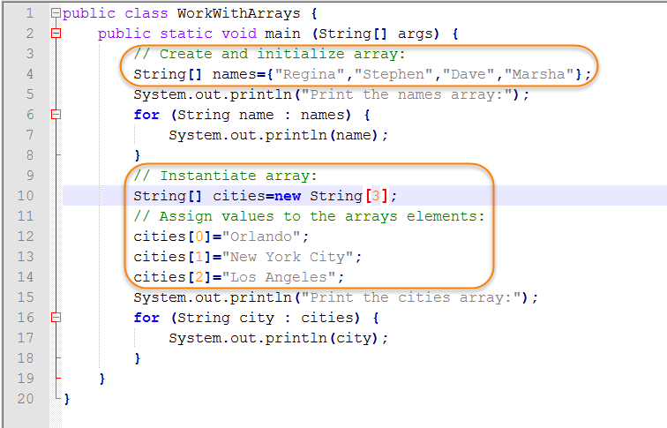
Array

Slide 55
Array
Find sum of all the elements in an array.
Count the elements less than 0.
Find the largest or smallest number in the array.
Copying the array.
Count the number of times that an element in array is equal to the element that follows it.

Slide 56
Array
Find sum of all the elements in an array.

Slide 57
Array
25
-5
-8
5
5
sum :
0
sum = sum + A[i];

Slide 58
Array
25
-5
-8
5
5
sum :
25
Sum = sum + A[i]; // i = 0

Slide 59
Array
25
-5
-8
5
5
sum :
20
Sum = sum + A[i]; // i = 1

Slide 60
Array
25
-5
-8
5
5
sum :
12
Sum = sum + A[i]; // i = 2

Slide 61
Array
25
-5
-8
5
5
sum :
17
Sum = sum + A[i]; // i = 3

Slide 62
Array
25
-5
-8
5
5
sum :
22
Sum = sum + A[i]; // i = 4

Slide 63
Array
Count the elements greater than 0.

Slide 64
Array
25
-5
-8
5
5
count :
0
if( A[i] > 0)
count = count + 1; // count++

Slide 65
Array
25
-5
-8
5
5
count :
1
if( A[i] > 0)
count = count + 1; // count++

Slide 66
Array
25
-5
-8
5
5
count :
1
if( A[i] > 0)
count = count + 1; // count++

Slide 67
Array
25
-5
-8
5
5
count :
1
if( A[i] > 0)
count = count + 1; // count++

Slide 68
Array
25
-5
-8
5
5
count :
2
if( A[i] > 0)
count = count + 1; // count++

Slide 69
Array
25
-5
-8
5
5
count :
3
if( A[i] > 0)
count = count + 1; // count++

Slide 70
Array
Find the smallest number in the array.

Slide 71
Array
25
-5
-8
5
5
smallest :
25
//A[0]
if( A[i] < smallest)
smallest = A[i];

Slide 72
Array
25
-5
-8
5
5
//Loop starts at i = 1
smallest :
-5
if( A[i] < smallest)
smallest = A[i];

Slide 73
Array
25
-5
-8
5
5
smallest :
-8
if( A[i] < smallest)
smallest = A[i];

Slide 74
Array
25
-5
-8
5
5
smallest :
-8
if( A[i] < smallest)
smallest = A[i];

Slide 75
Array
25
-5
-8
5
5
smallest :
-8
if( A[i] < smallest)
smallest = A[i];

Slide 76
Array
Copying the array.

Slide 77
Array
25
-5
-8
5
5
A_copy :
0
0
0
0
0
A_copy[i] = A[i];

Slide 78
Array
25
-5
-8
5
5
A_copy :
25
0
0
0
0
A_copy[i] = A[i]; // i = 0

Slide 79
Array
25
-5
-8
5
5
A_copy :
25
-5
0
0
0
A_copy[i] = A[i]; // i = 1

Slide 80
Array
25
-5
-8
5
5
A_copy :
25
-5
-8
0
0
A_copy[i] = A[i]; // i = 2

Slide 81
Array
25
-5
-8
5
5
A_copy :
25
-5
-8
5
0
A_copy[i] = A[i]; // i = 3

Slide 82
Array
25
-5
-8
5
5
A_copy :
25
-5
-8
5
5
A_copy[i] = A[i]; // i = 4

Slide 83
Array
Count the number of times that an element in array is equal to the element that follows it.

Slide 84
Array
25
-5
-8
5
5
count :
0
if( A[i] == A[i+1])
count = count + 1; // count++
Note : we should traverse from i=0 to i< A.length - 1

Slide 85
Array
25
-5
-8
5
5
// i=0
count :
0
if( A[i] == A[i+1])
count = count + 1; // count++
Note : we should traverse from i=0 to i< A.length - 1

Slide 86
Array
25
-5
-8
5
5
// i=1
count :
0
if( A[i] == A[i+1])
count = count + 1; // count++
Note : we should traverse from i=0 to i< A.length - 1

Slide 87
Array
25
-5
-8
5
5
// i=2
count :
0
if( A[i] == A[i+1])
count = count + 1; // count++
Note : we should traverse from i=0 to i< A.length - 1

Slide 88
Array
25
-5
-8
5
5
// i=3
count :
1
if( A[i] == A[i+1])
count = count + 1; // count++
Note : we should traverse from i=0 to i< A.length - 1

Slide 89
Classes & Objects
class declaration
creating objects
methods
constructors and constructor overloading
garbage collector
importance of static keyword and examples
this keyword
arrays
command line arguments
nested classes

Slide 90
Command line arguments
A command-line argument is the information that directly follows the program’s name on the command line when it is executed.
Command-line arguments are stored as strings in a String array passed as argument to main().

Slide 91
Command line arguments
The first command-line argument is stored at args[0], the second at args[1], and so on.
It is not necessary to pass the length of the string array as in c, because array class has a member which gives the length of the array.
args[0] is not the file name as in c command line arguments.

Slide 92
Command line arguments
class CommandLine {
public static void main(String args[]) {
for(int i=0; i<args.length; i++)
System.out.println("args[" + i + "]: " + args[i]);
}
}
Try executing this program, as shown here:
java CommandLine this is a test 100 -1

Slide 93
Classes & Objects
class declaration
creating objects
methods
constructors and constructor overloading
garbage collector
importance of static keyword and examples
this keyword
arrays
command line arguments
nested classes

Slide 94
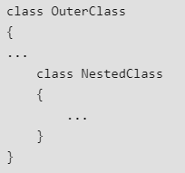
Nested classes
A class defined within another class is known as nested class.

Slide 95
Nested classes
There are two types of nested classes:
static and
non-static. # inner class
A static nested class is the one that had static modifier applied.

Slide 96
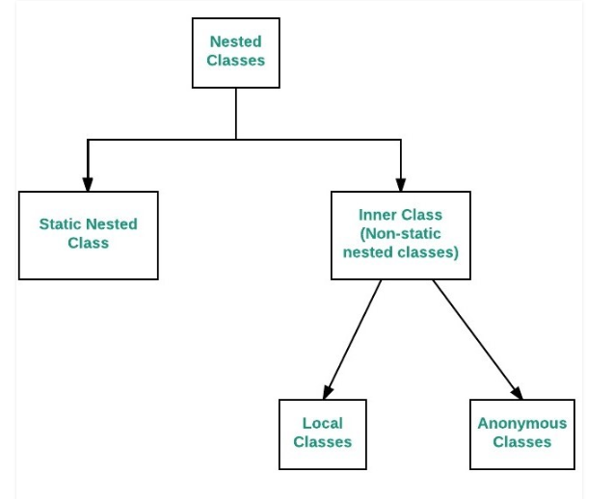
Nested classes

Slide 97
Nested Class
A Static class cannot refer to the members of its enclosing class directly. Due to this restriction this is used seldom.
Non-static nested class has access to all the variables and methods of its outer class and can refer to them directly.

Slide 98
Nested classes
The scope of the nested class is bounded by the scope of its enclosing class.
The inner class has access to the members (including the private members) of the enclosing class.
The enclosing class has no access to the members of the nested class.

Slide 99
Nested Class
Nested classes are helpful while handling events.
These are added in java 1.1.

Slide 100
Exercise
Create a Point class has variables int x and int y. Provide parameterized constructor.
Create a class Rectangle. Point p1 is the bottom-left corner and Point p2 is the top-right corner. Write two constructors, one to take Point p1 and Point p2 as arguments and the other to take width and height (in this case (0,0) will be the bottom-left corner). It should have methods to calculate the perimeter() and the area() of the rectangle, move the rectangle by deltax and deltay, find out if a Point p is inside the rectangle or not. Method isInside(Point p). It should also have get methods for both width and height. Write a drive program to test your class.

Slide 101
Questions
Define class and object in java.
What is a Constructor? What is the main purpose of Constructors? How to invoke a constructor in JAVA?
Illustrate constructor overloading. Give the brief note on operators in java.
What are objects and how they are created from Class? Explain the dynamic initialization of objects using constructors.
When to use a Static variable in JAVA programming? Explain the importance of Static Variable with a JAVA program.

Slide 102
Questions
What is the need of garbage collection in Java?
How to share the data among the functions with the help of static keyword? Explain the same with an example.
Explain the usage of constructor and types of constructors in Java.
Write the purpose of this keyword in Java.
Can we use constructors with parameters? What type of parameters can be passed for this? Explain the same with an example.
Illustrate the importance of this keyword in java.
Can we use constructors with parameters? What kind of parameters can be given? Explain with area of various geometric shapes example.

Slide 103
Questions
Write the purpose of static keyword in Java.
Write a Java program to overload a constructor.
Write the importance of command line arguments.
Write a Java program which accepts the input from keyboard to display Fibonacci series.
Write the importance of static constructor.
Elaborate the use of static and nesting members in Java with suitable examples.
How to assign the values to the variables in the class during the time of creation of an object to that class? Explain with an example.

Slide 104
Questions
With an example program explain the concept of classes and nested classes in java.
Relate objects, classes and methods.
Design a class that represents a bank account and construct the methods to i) Assign initial values ii) Deposit an amount iii) Withdraw amount after checking balance iv) Display the name and balance.
Do you need to use static keyword for the above bank account program? Explain.
Why do we need Nested classes in JAVA programming? Explain the types of non-static nested classes with a JAVA program.

Slide 105
Questions
Write about multidimensional arrays in java.
What is the importance of constructor? Write a java program to perform constructor overloading.
Describe the usage of static members and nesting members with suitable example programs in java.
Discuss declaration, allocation and accessing array elements in java with matrix multiplication example.
Write about command line arguments. Accept the input from keyboard to display Fibonacci series.
Specify the importance of garbage collection.
Write a Java program to demonstrate garbage collection.

